Slide 1
Group 3 Richard Andy Francis Guilliano

Slide 2
Hybrid Intelligent Systems Group 3

Slide 3
INTRODUCTION
Computational intelligence offers an innovative framework for building intelligent hybrid architectures using Neural Networks (NN), Fuzzy Inference Systems (FIS), Probabilistic Reasoning (PR), Evolutionary Computation (EC), and Swarm Intelligence (SI).
Existing hybridization approaches in computational intelligence commonly rely on ad hoc design methodologies driven by success in specific application domains.
The lack of a common framework makes it challenging to conceptually compare different hybrid systems and evaluate their performance comparatively.
Overcoming the absence of a unified framework is essential for better conceptual understanding and improved performance evaluation of hybrid systems in computational intelligence.

Slide 4
INTRODUCTION
Adaptive hybrid computational intelligence frameworks have been developed, offering a diverse range of approaches for solving complex problems.
These frameworks integrate different knowledge representation schemes, decision-making models, and learning strategies, allowing for a more comprehensive and effective solution to computational tasks.
The primary objective of this integration is to overcome the limitations inherent in individual techniques by leveraging the strengths and compensating for the weaknesses through hybridization.
By combining and fusing various techniques, these hybrid frameworks enhance performance, increase robustness, and improve the overall efficiency of computational intelligence systems.

Slide 5
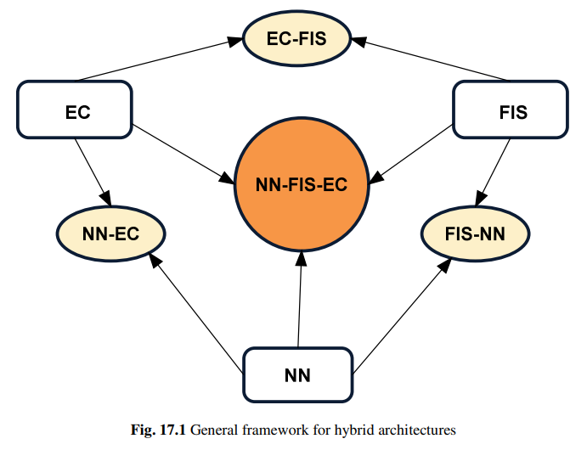
INTRODUCTION
Synthesis of various techniques is essential to achieve a highly intelligent system.
The integration and interaction of different techniques play a crucial role in the development of hybrid soft computing architectures.
Designing hybrid systems should prioritize the integration and interaction of techniques, rather than simply merging methods to create new techniques.
Well-understood techniques should be applied to solve specific domain problems within the system, and their weaknesses can be addressed by combining them with complementary methods.

Slide 6
Introduction
Neural networks (NN) mimic the neurological mechanisms of the brain and offer a structured architecture with learning and generalization capabilities.
NN stores knowledge in its weights, which are determined through learning from known samples, allowing for distributive knowledge representation.
Incorporating human a priori knowledge into NN is challenging due to the distributed nature of its knowledge representation, which is a key strength of the connectionist paradigm.
The generalization ability of NN for new inputs relies on the inherent algebraic structure within the network.

Slide 7
Introduction
Fuzzy inference systems (FIS) on the other hand provide a powerful framework for approximate reasoning, aiming to model the human reasoning process at a cognitive level.
FIS acquire knowledge from domain experts and encode it within the algorithm using if-then rules, enabling straightforward incorporation and interpretation of knowledge.
FIS employ a rule-based approach and interpolative reasoning to handle new inputs effectively.
Learning and adaptation pose significant challenges in FIS, contrasting with the ease of knowledge incorporation and interpretation.

Slide 8
Introduction
Probabilistic reasoning, such as Bayesian belief networks, provides a mechanism for evaluating system outcomes influenced by randomness or other forms of probabilistic uncertainty.
An essential advantage of probabilistic reasoning is its capability to update previous outcome estimates by incorporating newly available evidence, allowing for dynamic and iterative decision-making processes.
Bayesian belief networks offer a probabilistic graphical model that represents relationships between variables and their probabilities, enabling effective reasoning under uncertainty.
The ability to update outcome estimates based on new evidence enhances the accuracy and reliability of decision-making in systems employing probabilistic reasoning.

Slide 9
Introduction
Global optimization aims to find the best set of parameters for an objective function but can be challenging due to locally optimal solutions and NP-hardness in combinatorial problems.
Evolutionary Computation simulates evolution on a computer by iteratively evolving a population of candidate solutions through selection, crossover, and mutation.
The selection operation guides the evolutionary process by determining which candidate solutions progress to the next generation, limiting the search space.
Evolutionary Computation leverages genetic operators to introduce variation and explore the solution space, improving candidate solutions over generations.
This approach has proven successful in various domains, providing effective solutions to complex optimization problems.
By combining evolutionary principles with computational techniques, Evolutionary Computation offers a powerful framework for global optimization.

Slide 10
Models of Hybrid Computational Intelligence Architectures
Hybrid intelligent architectures can be categorized into four main types based on the system's overall architecture
Stand-alone
Transformational
Hierarchical hybrid
Integrated hybrid.

Slide 11
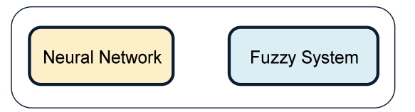
Models of Hybrid Computational Intelligence Architectures
Standalone
Stand-alone models consist of independent software components, which do not interact in any way
Developing stand-alone systems can have several purposes:
they provide a direct means of comparing the problem solving capabilities of different techniques with reference to a certain application
Running different techniques in a parallel environment permits a loose approximation of integration
often used to develop a quick initial prototype, while a more time-consuming application is developed

Slide 12
Models of Hybrid Computational Intelligence Architectures
Standalone
Some of the benefits are simplicity and ease of development by using commercially available software packages.
On the other hand, stand-alone techniques are not transferable: neither can support the weakness of the other technique.

Slide 13
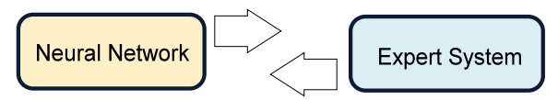
Models of Hybrid Computational Intelligence Architectures
Transformational Hybrid Intelligent Systems
Transformational hybrid models involve starting with one type of technique and transitioning to another.
The choice of development and delivery techniques is based on the desirable features each technique offers.
In this model, the expert system may be insufficient in solving the problem adequately, or the speed, adaptability, and robustness of a neural network may be required.
Knowledge from the expert system is utilized to determine initial conditions and the training set for the artificial neural network.

Slide 14
Models of Hybrid Computational Intelligence Architectures
Transformational Hybrid intelligent Systems
Transformational hybrid models are quick to develop and require maintenance on a single system, offering operational benefits tailored to the environment.
However, these models have significant limitations, often being application-specific.
For a different application, a completely new development effort might be needed to transform an expert system to a neural network or vice versa.
There is a need for fully automated approaches to facilitate the transformation between different techniques in transformational hybrid models.

Slide 15
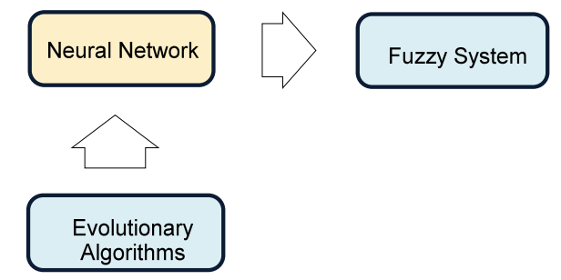
Models of Hybrid Computational Intelligence Architectures
Hierarchical Hybrid intelligent Systems
Hierarchical hybrid architectures are constructed in a hierarchical manner, where each layer serves a different functionality.
The correct functioning of all layers is crucial for the overall performance of the model.
In this architecture, the neural network utilizes an evolutionary algorithm to optimize its performance, and the network output serves as a pre-processor for the fuzzy system, which generates the final output.
The performance of each layer directly impacts the quality of the final output. Poor performance in any layer will affect the overall output of the system

Slide 16
Models of Hybrid Computational Intelligence Architectures
Integrated Intelligent Systems
Fused architectures represent integrated intelligent systems that combine different techniques into a single computational model.
These architectures involve shared data structures and knowledge representations.
An alternative approach is to place various techniques side-by-side and focus on their interaction during problem-solving tasks, enabling the integration of different techniques and leveraging their mutual benefits.
Integrated models provide benefits such as robustness, improved performance, and enhanced problem-solving capabilities.

Slide 17
Models of Hybrid Computational Intelligence Architectures
Integrated Intelligent Systems
Fully integrated models can exhibit a wide range of capabilities, including adaptation, generalization, noise tolerance, and justification.
Fused systems, such as neuro-fuzzy systems, evolutionary neural networks, and evolutionary fuzzy systems, illustrate examples of integrated models.
However, building fully integrated models is complex due to the increased complexity of inter-module interactions, and the process of specifying, designing, and constructing them poses challenges.

